Slide 1
Alaska Commission on Postsecondary Education
Strategic Planning Wrap Up
January 2024

Slide 2
The Why

Slide 3
Project Recap – Phase I
Internal Assessment & External Discovery
Senior Manager Deep Dive
Employee Engagement
Stakeholder Engagement
Consumer Engagement
Commissioner Engagement
Key Outputs:
Vision & Mission Refresh
Strategic Priorities v 1
Key Goals v1

Slide 4
Project Recap – Phase II
Alignment & Pathfinding
Vision & Mission Refinement
Strategic Goals Finalized
Employee Alignment
Commission Approval of Vision, Mission & Priorities
Key Outputs:
Strategic Plan
Performance Blueprint

Slide 5
Project Recap – Phase III
Performance Implementation
Strategic Performance Blueprint with KPIs
Strategic Plan Artifacts
Quarterly Review & Reporting Cadence
Key Outputs:
Strategic Plan (internal)
Strategic Plan (external)
Strategy Overview (external)
Actionable Performance Blueprint

Slide 6
ACPE Strategic Plan Summary of Key Elements

Slide 7
Vision & Mission
Alaskans are educated and skilled contributors to our vibrant communities and economy.
The Alaska Commission on Postsecondary Education provides sustainable solutions for college, career and technical training.
We champion individuals and families through broad access to federal and state programs, grants, scholarships, and loans together with the tools and resources that allow them to make informed decisions about funding their education.
As the Higher Education Agency for the State of Alaska, we advance policy and foster collaboration to build a skilled workforce that meets the needs of communities and employers, supporting economic development across the state.

Slide 8
Guiding Principles
We operate with integrity in everything we do.
Every decision we make is based on compliance, balancing fairness and responsibility to our customers with our obligation to manage our financial resources to meet future needs.

Slide 9
Strategic Priorities
Become the education lender of choice in Alaska and for Alaskans.
Increase access to, and utilization of, federal and state education funding sources.
Operate a sustainable organization responsive to students, customers, stakeholders, and employees.
Position ACPE to help bridge the education gap in Alaska’s current and future workforce needs.

Slide 10
Strategic Goals
Increase visibility, understanding and awareness of ACPE and its products, resources, partnerships, and programs.
Offer loan programs responsive to consumer and organization needs.
Modernize and streamline the customer experience.
Enhance and refine financial planning resources appropriate for target audiences.
Foster an environment where employees thrive as the agency evolves.
Improve financial sustainability of ACPE.
Identify the current state of higher education programs and resources in Alaska

Slide 11
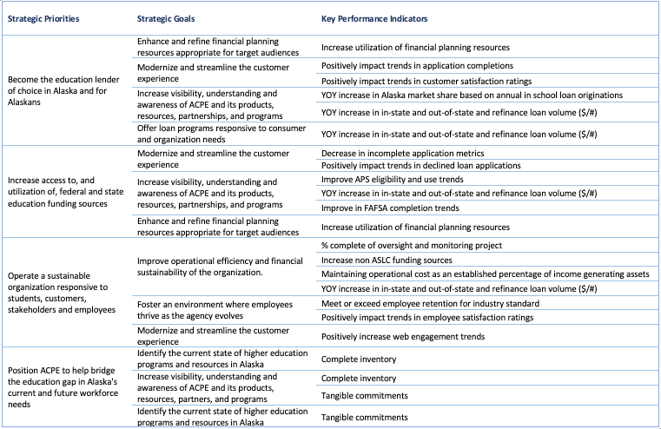
Key Performance Indicators

Slide 12
Final Steps
Finalize and publish Strategic Plan artifacts before the start of the 2024 Legislative Session
Implement the Strategic Plan using the Performance Blueprint
Monitor and Report on a quarterly basis

Slide 13
Thank You!
QUESTIONS?

